Slide 1
Week 2

Slide 2
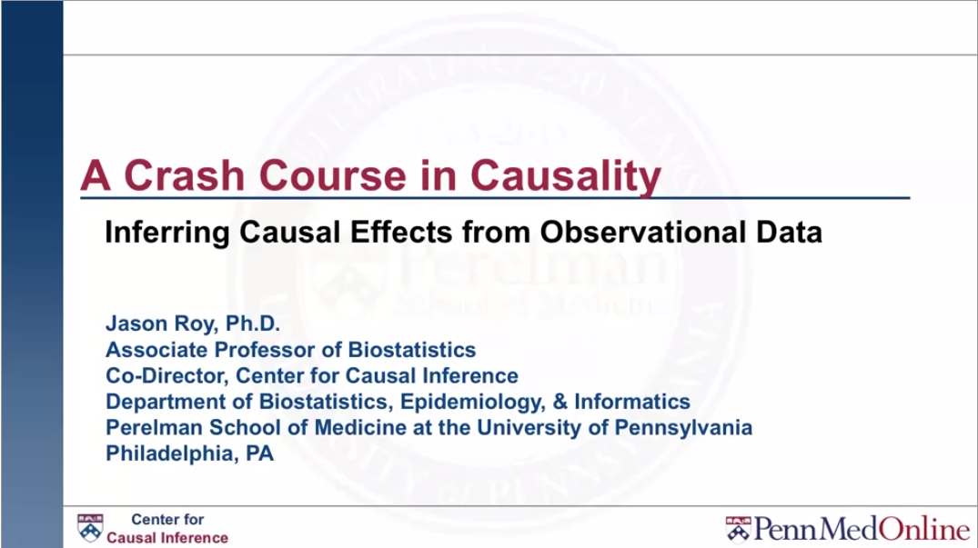

Slide 3
Confounding

Slide 4
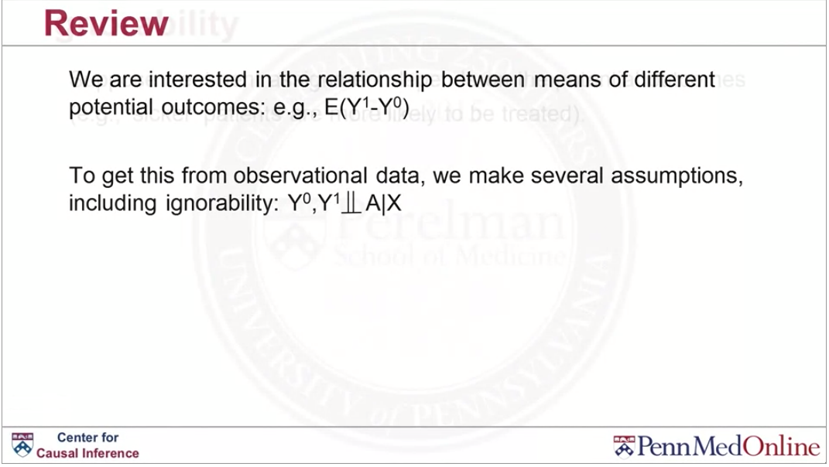

Slide 5
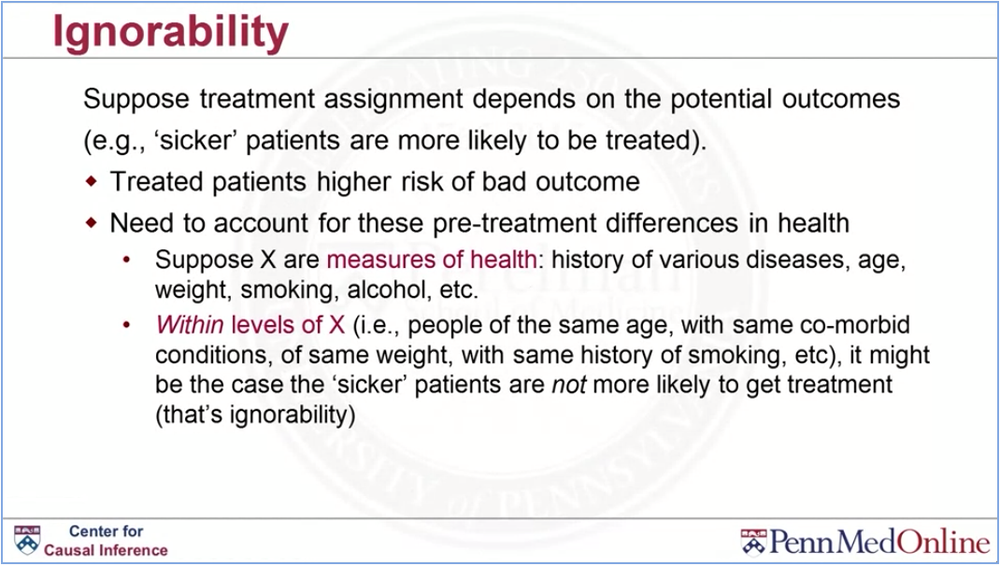

Slide 6
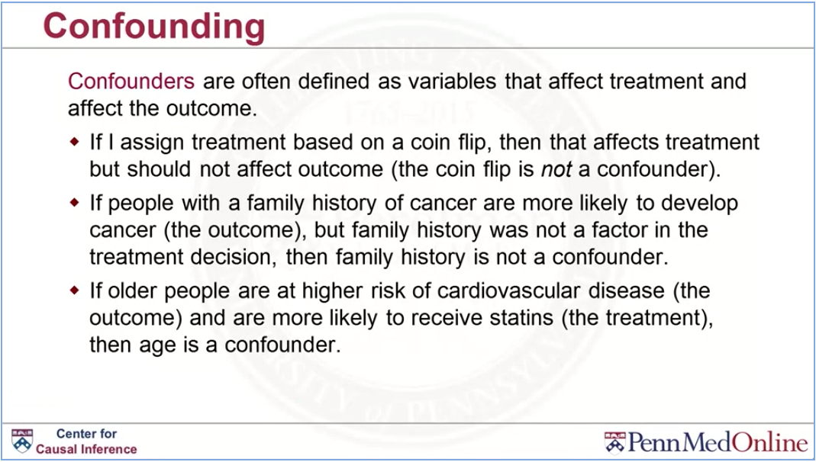

Slide 7
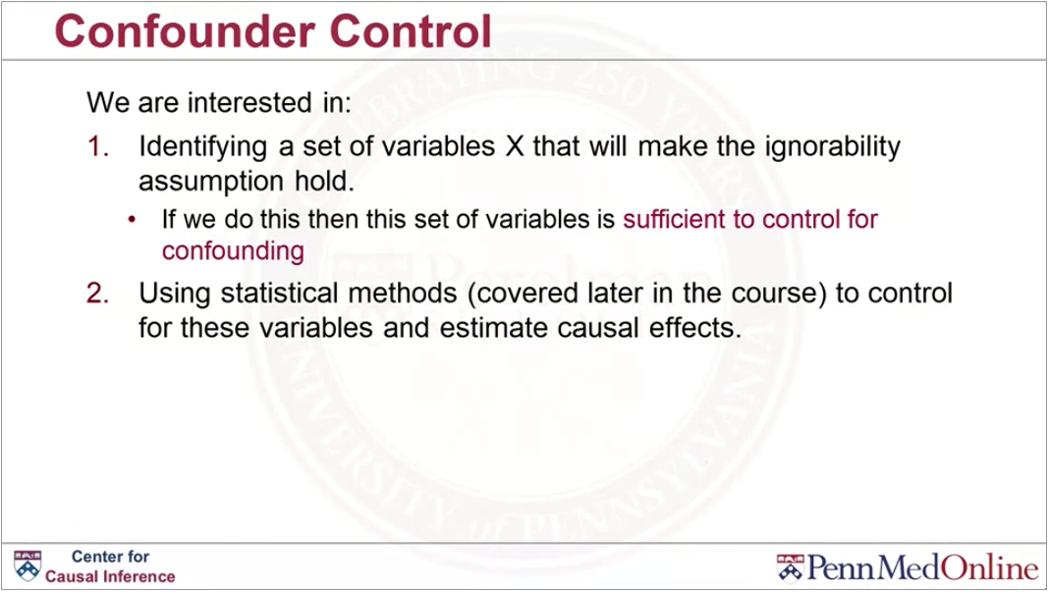

Slide 8
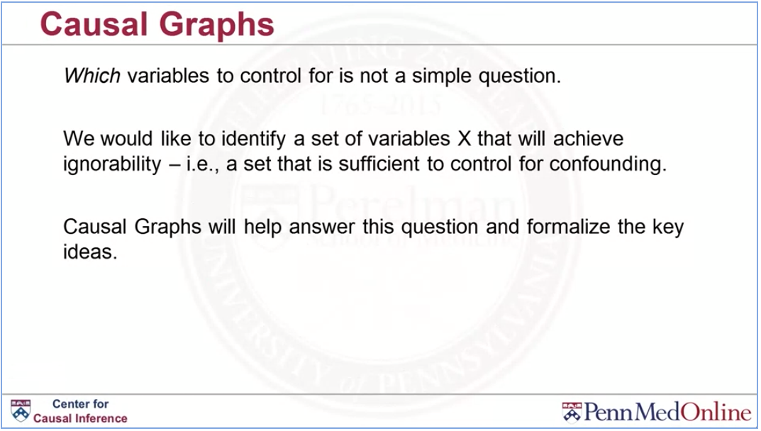

Slide 9
Causal graphs

Slide 10
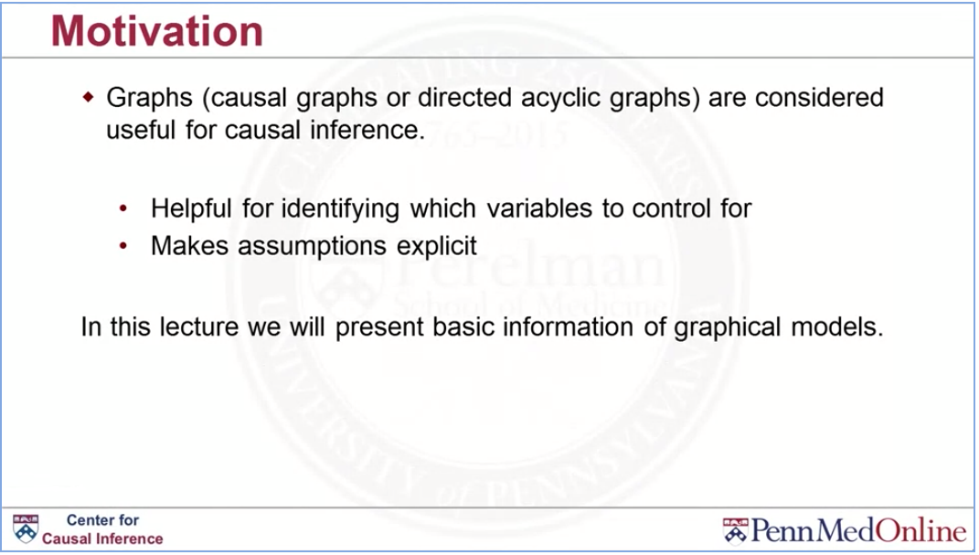

Slide 11
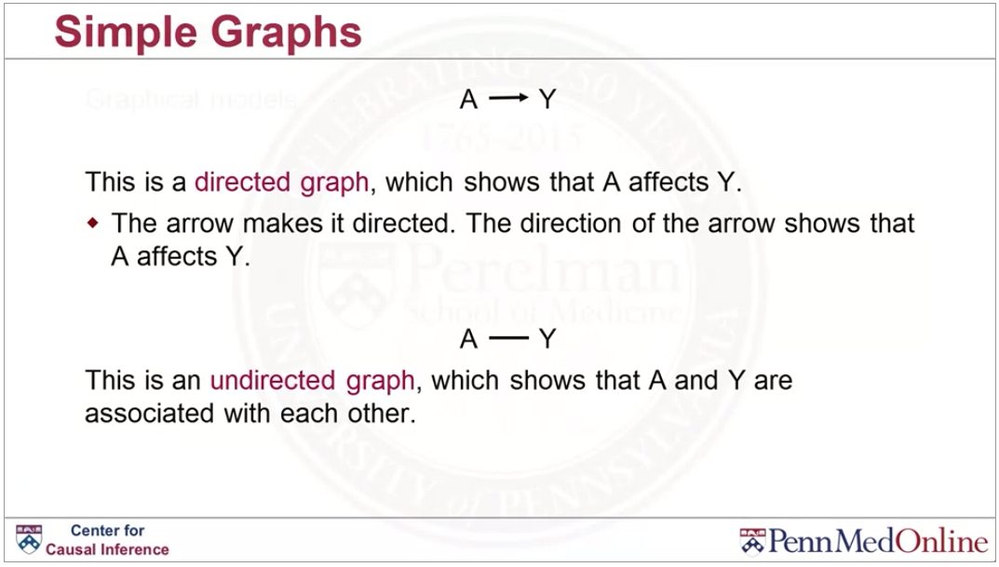

Slide 12
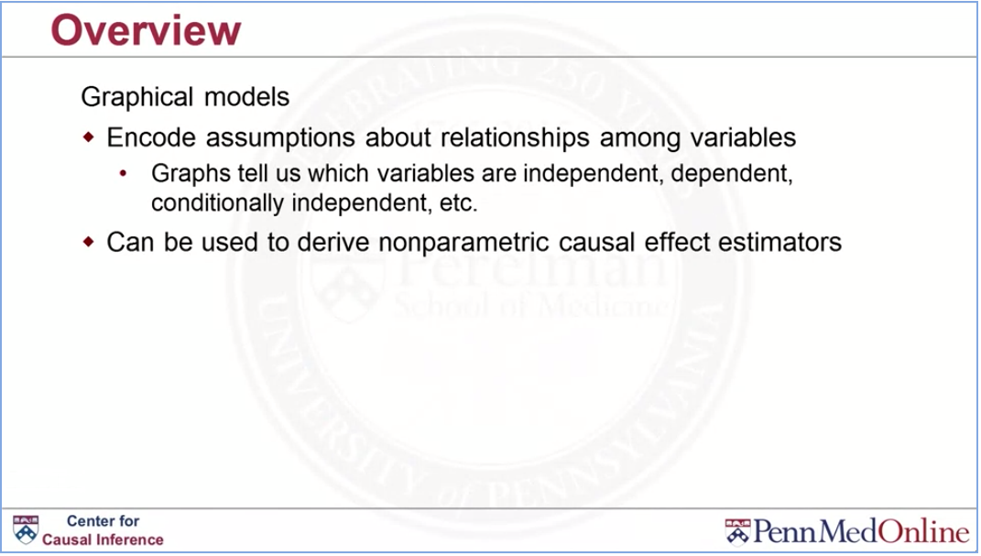

Slide 13
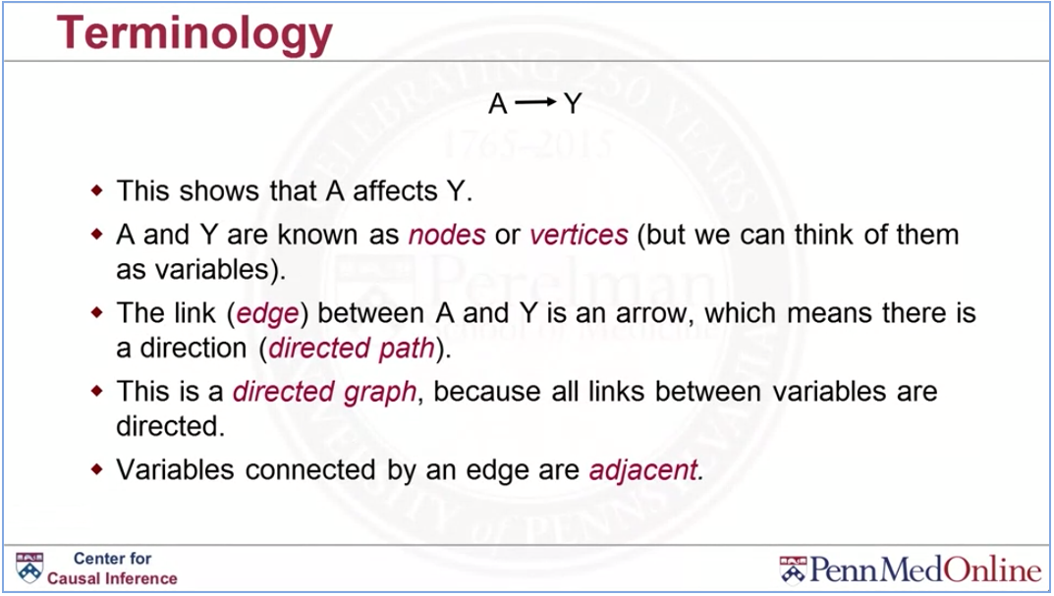

Slide 14
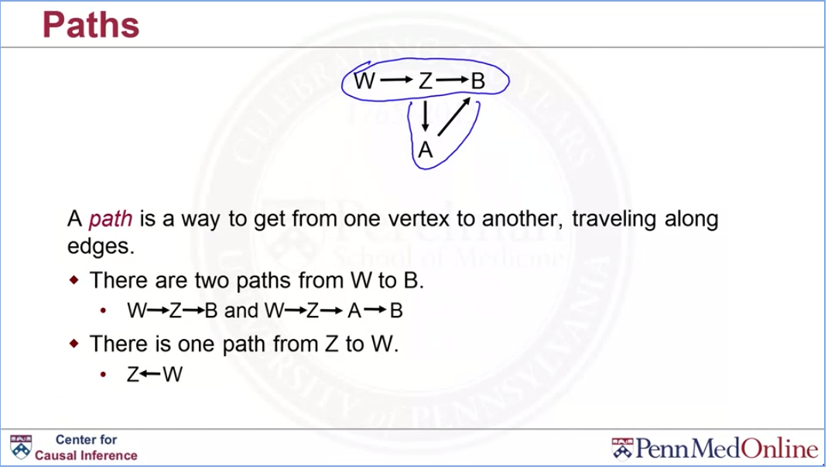

Slide 15
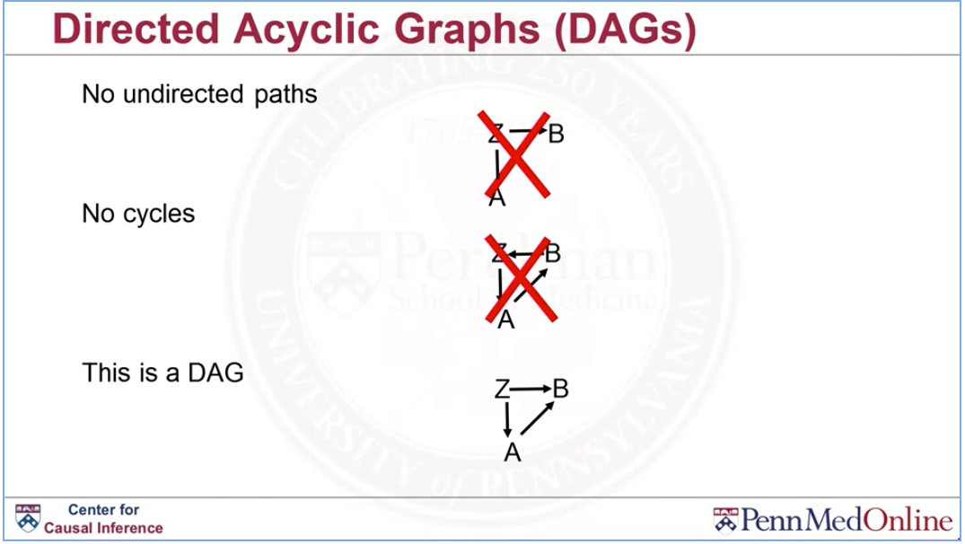

Slide 16
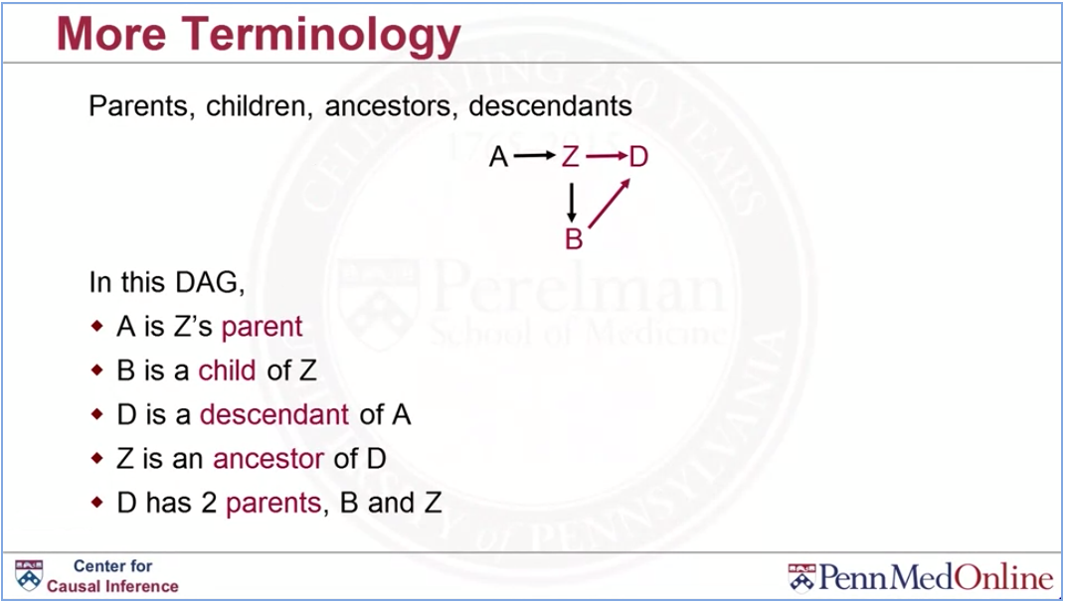

Slide 17
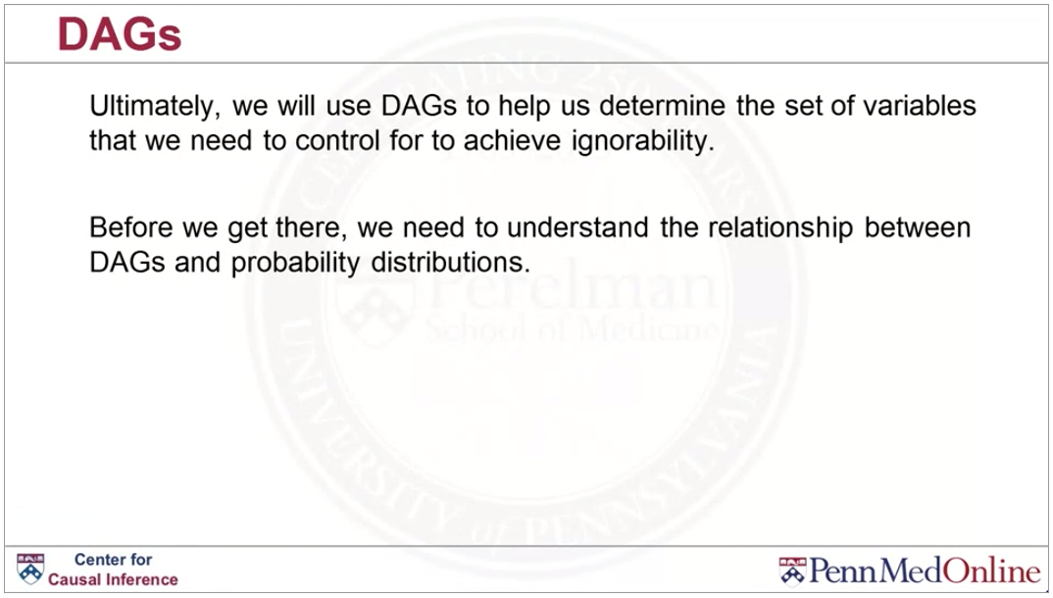

Slide 18
Relationship between DAGs and probability distributions

Slide 19
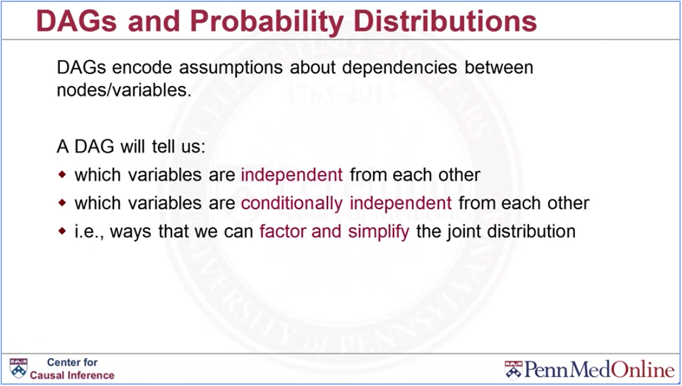

Slide 20
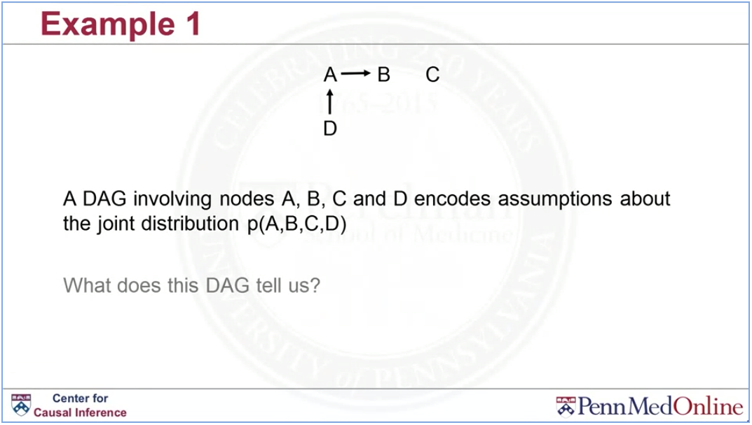

Slide 21
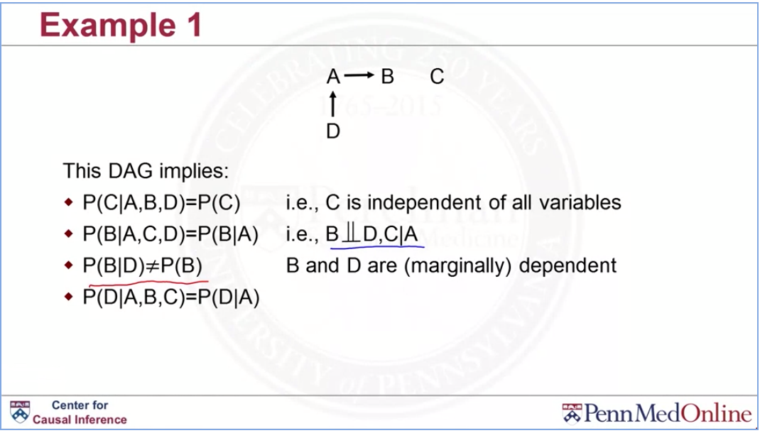

Slide 22
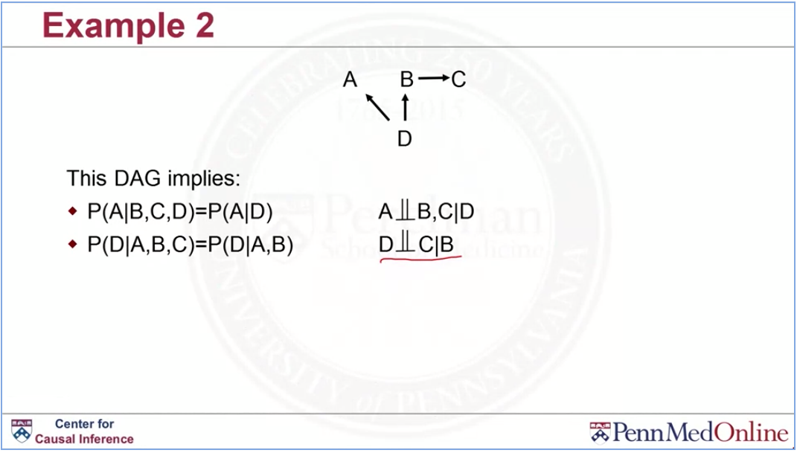

Slide 23
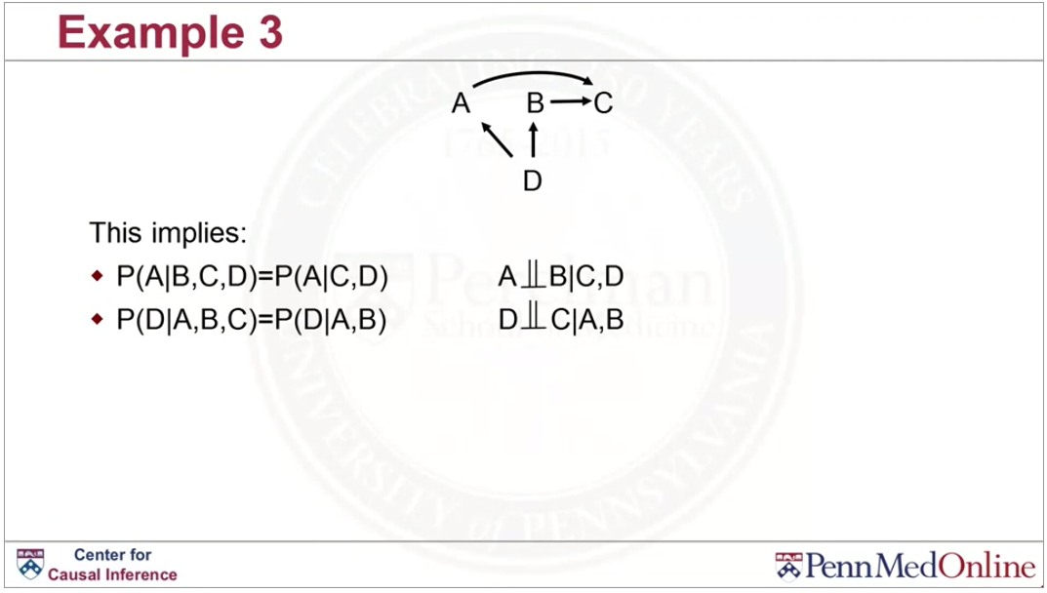

Slide 24
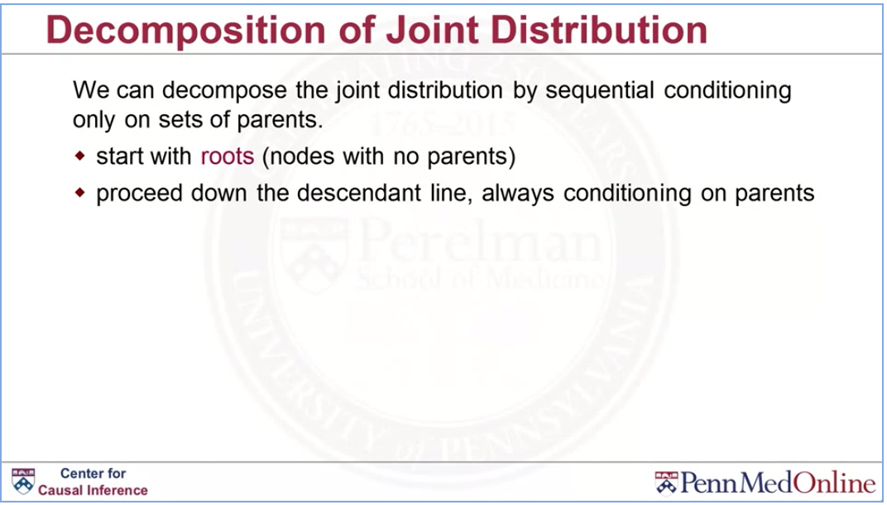

Slide 25
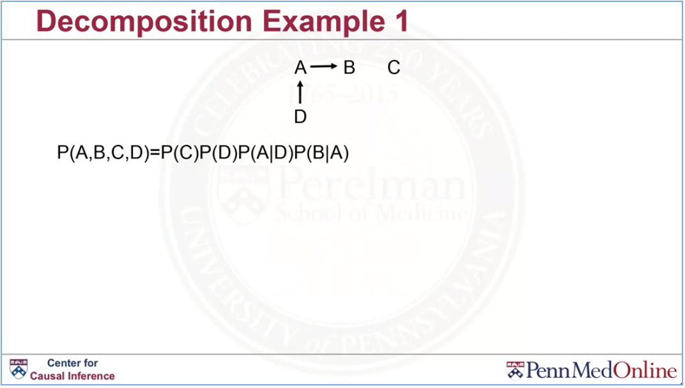

Slide 26
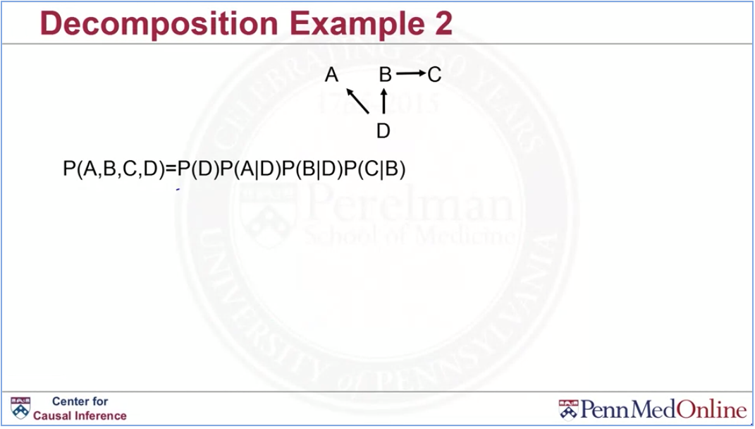

Slide 27
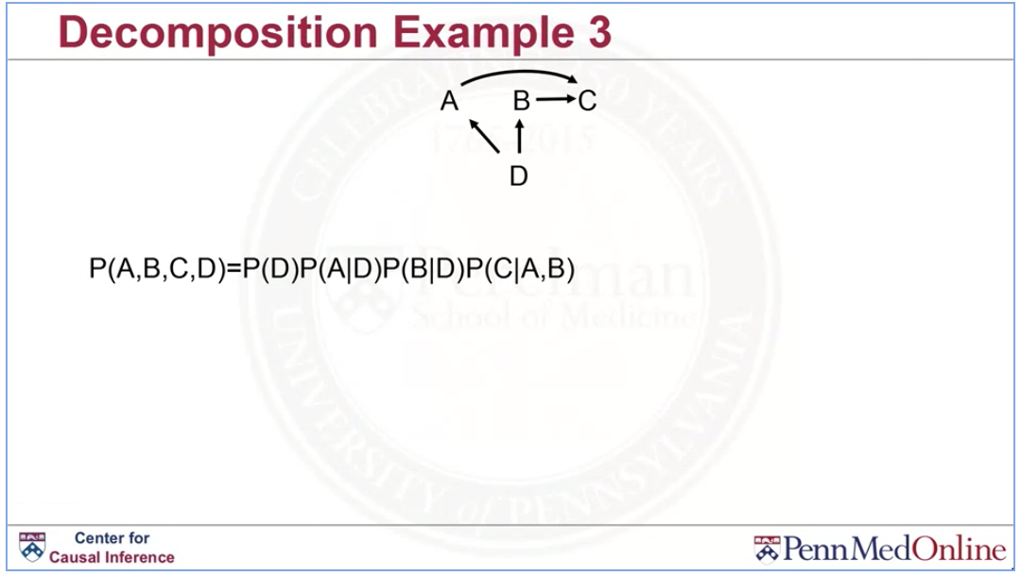

Slide 28
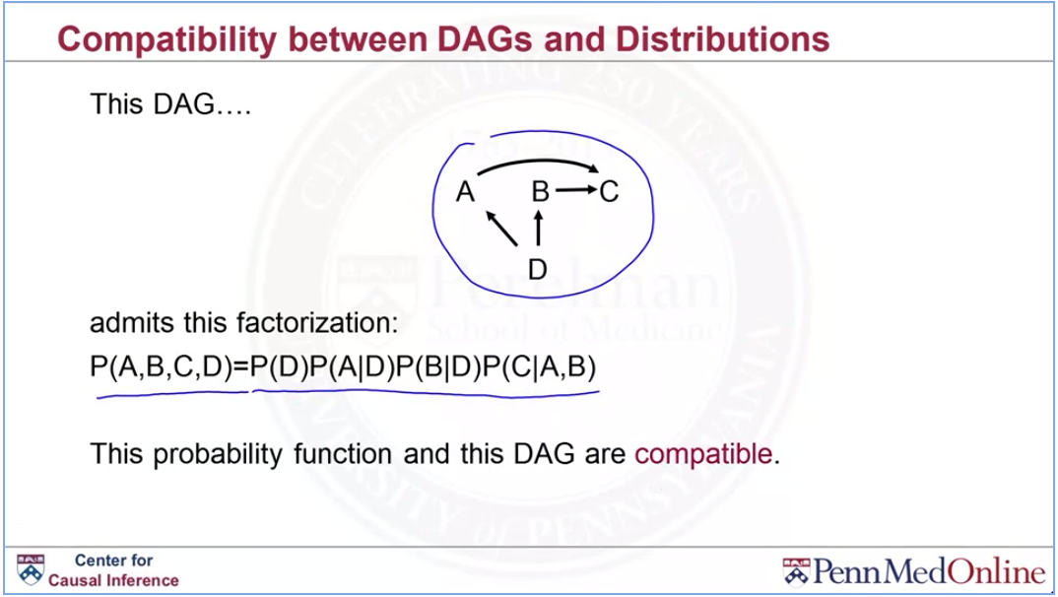

Slide 29
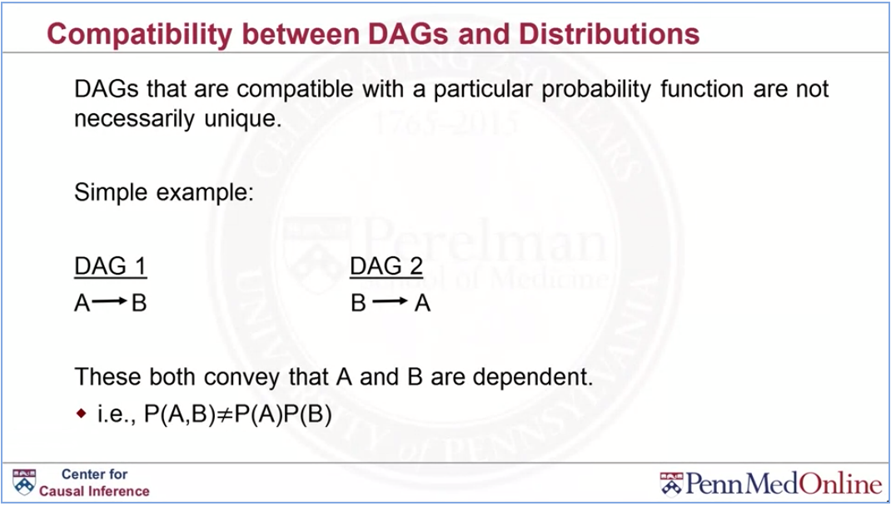

Slide 30
Paths and associations

Slide 31
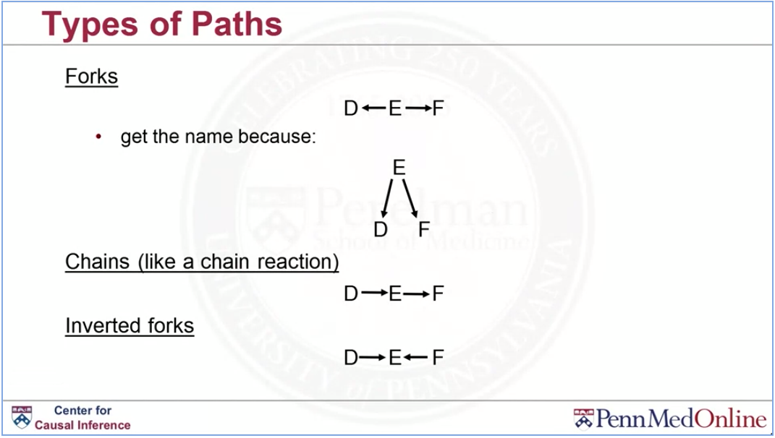

Slide 32
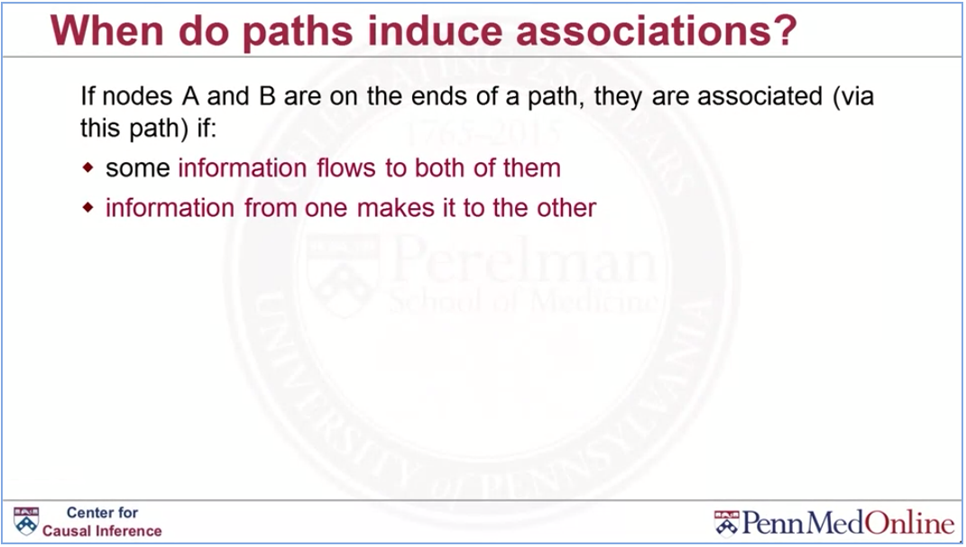

Slide 33
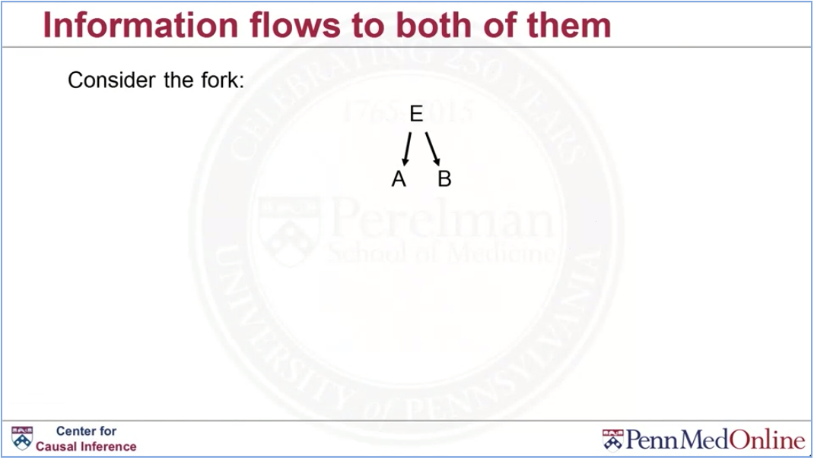

Slide 34
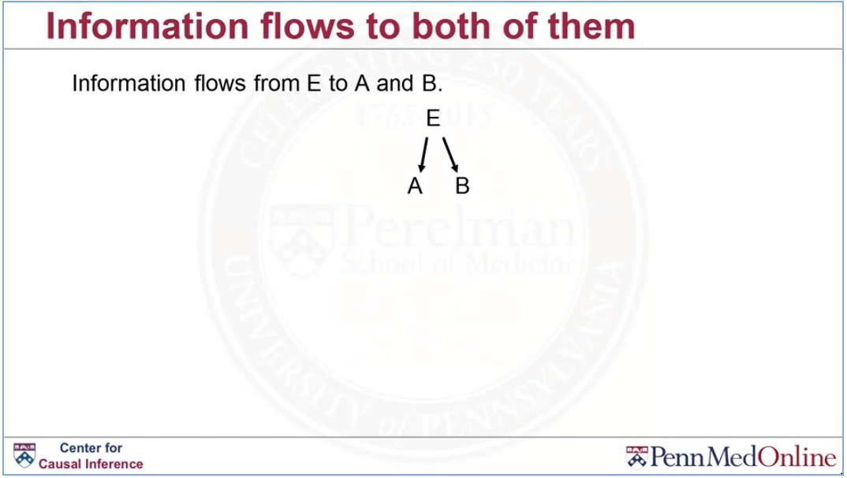

Slide 35
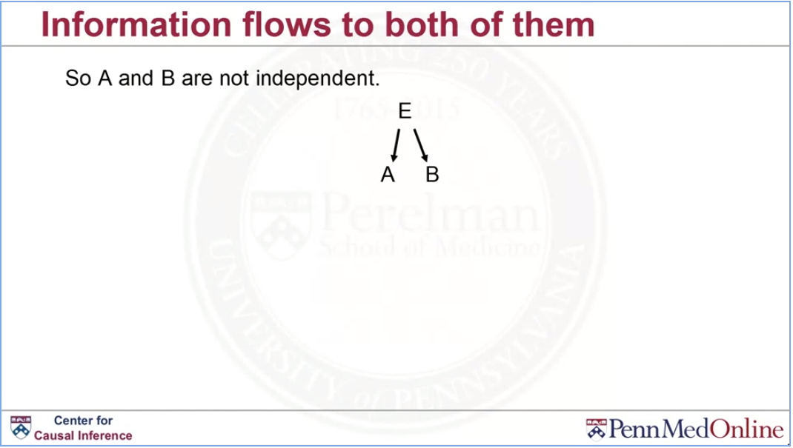

Slide 36
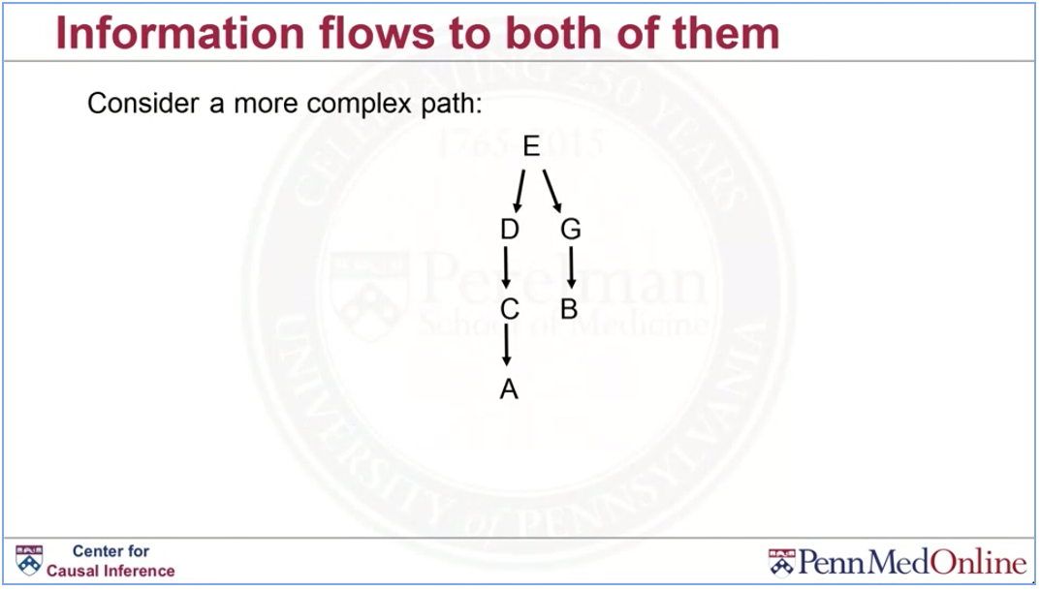

Slide 37
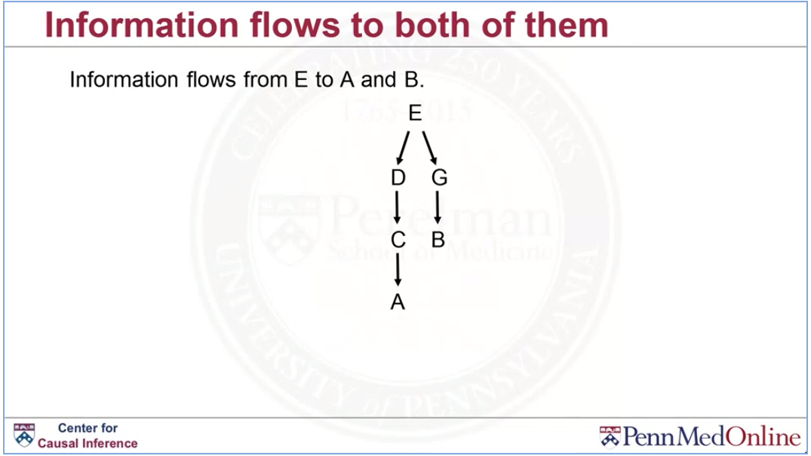

Slide 38
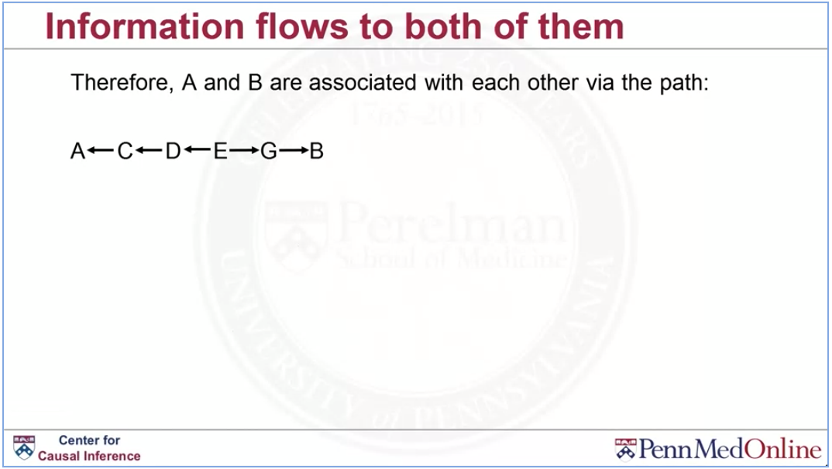

Slide 39
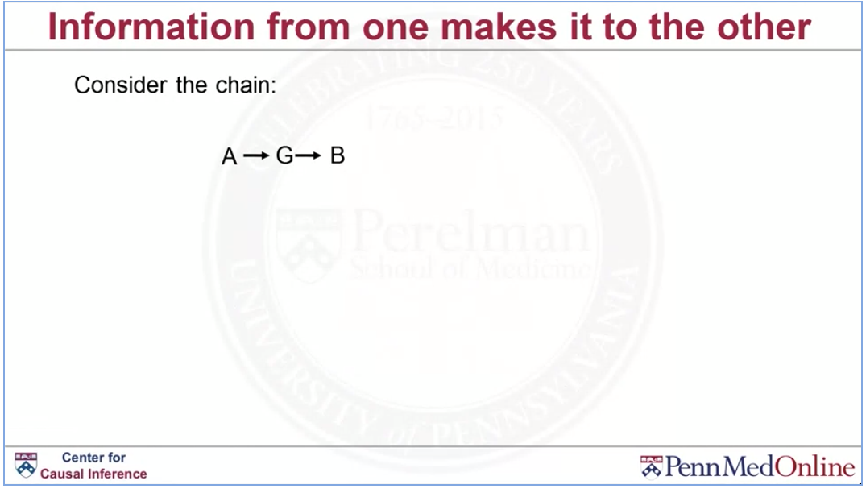

Slide 40
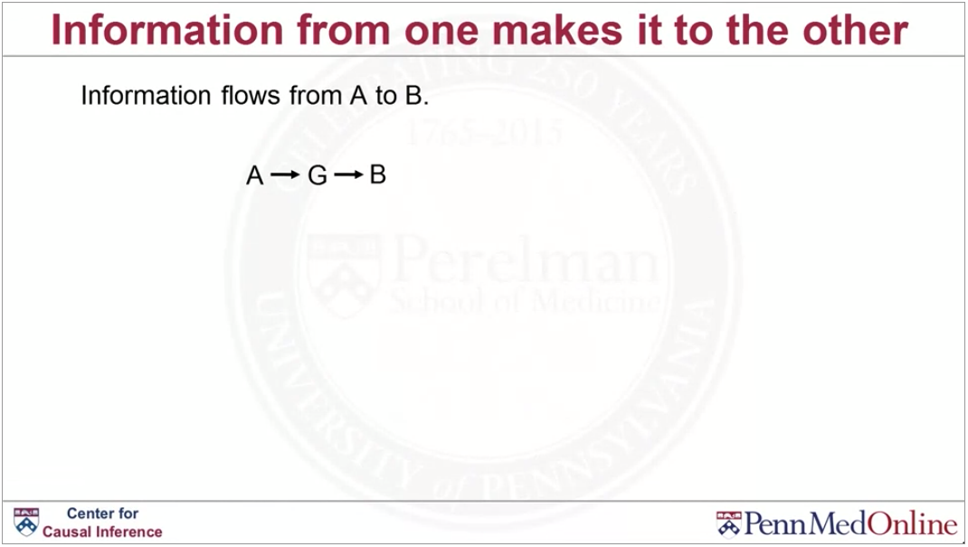

Slide 41
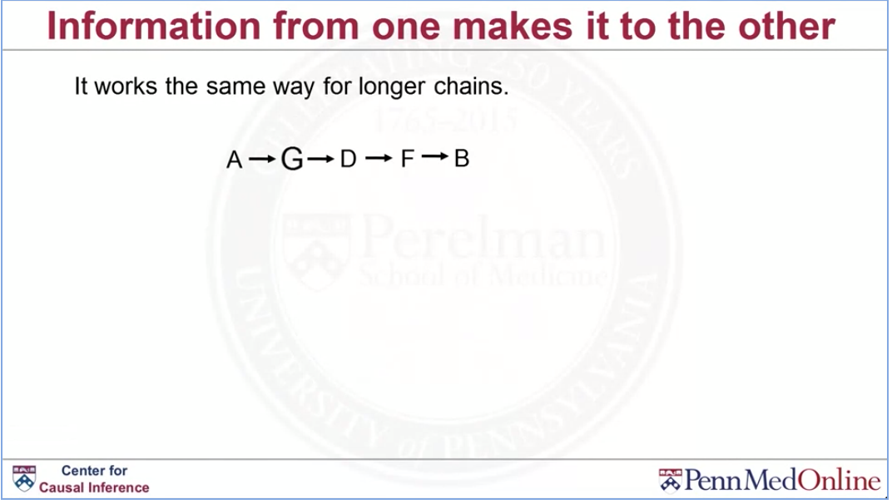

Slide 42
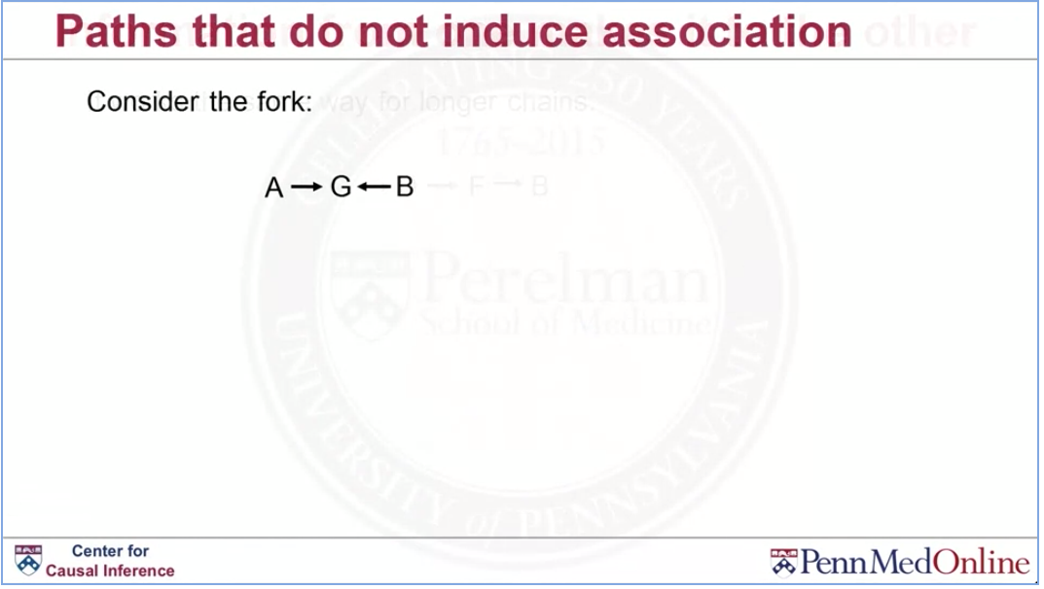

Slide 43
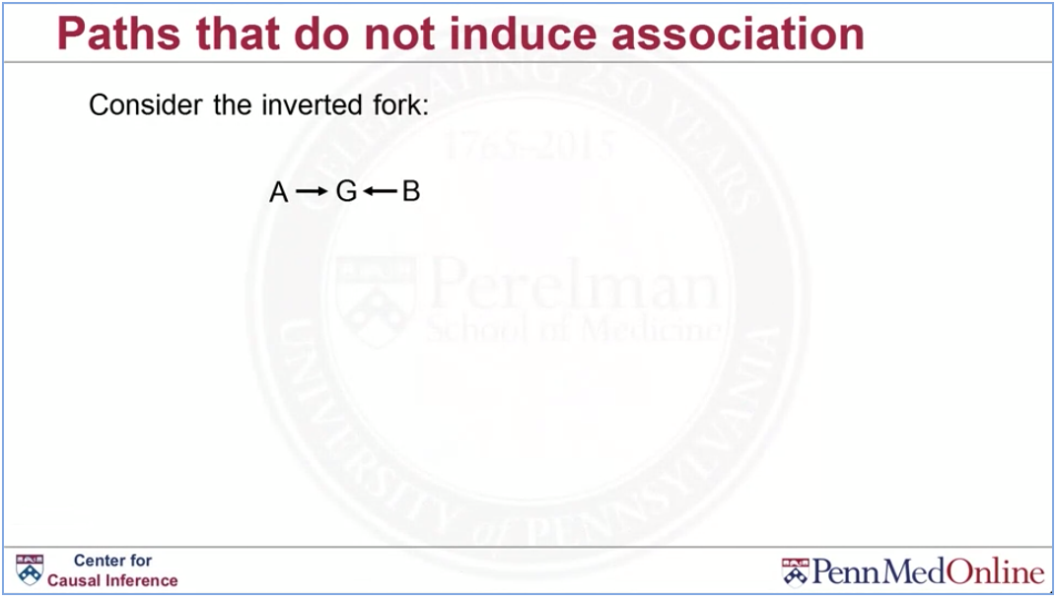

Slide 44
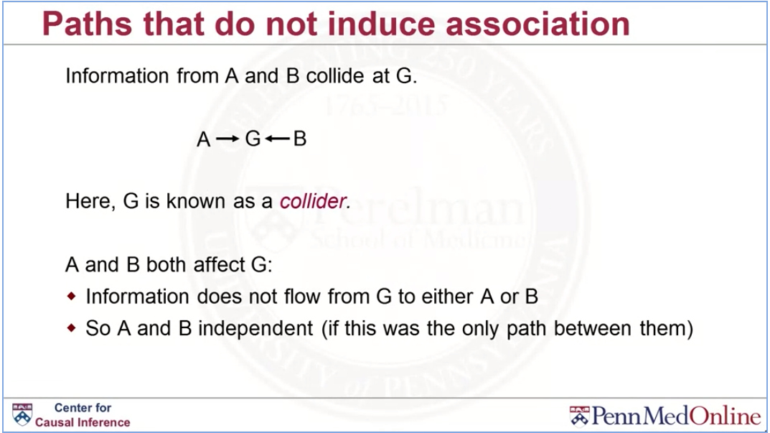

Slide 45
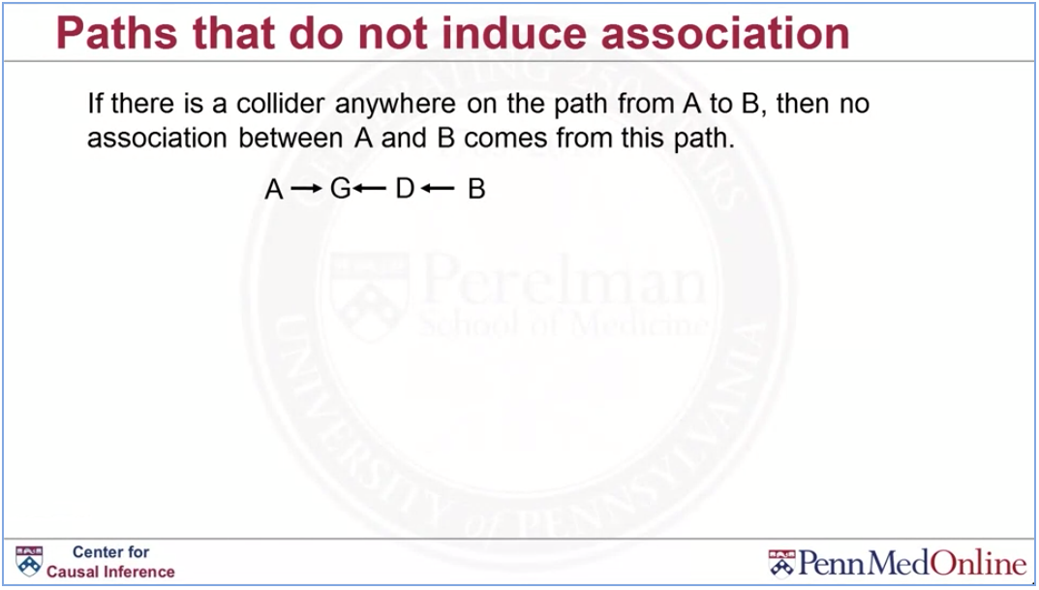

Slide 46
Conditional independence (d-separation)

Slide 47
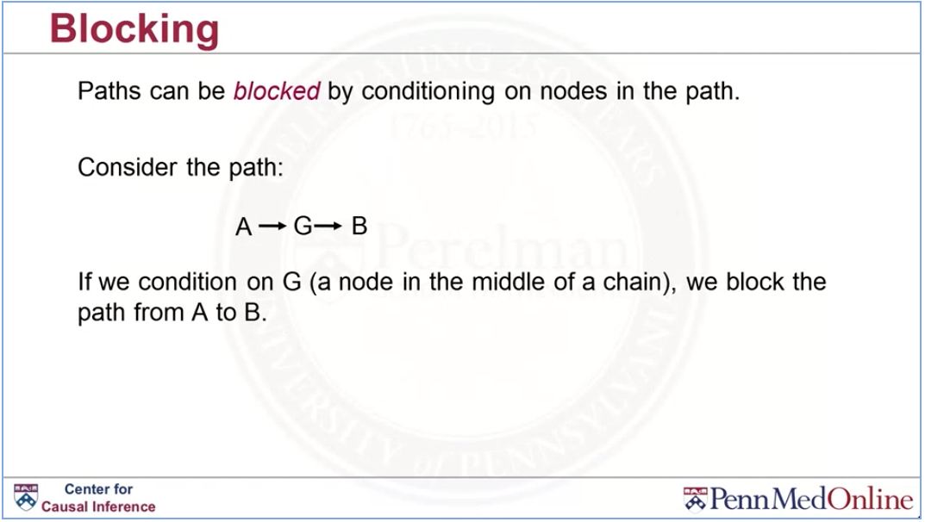
Notes:
So consider the path A affecting G, affecting B.
Imagine now that we condition on G.
That is a node in the middle of this chain.
In that case, we would block the path from A to B.
So previously, we showed that in a chain like this,
information does get from A to B.
So A and B are dependent, but they are dependent through G.
So, A affects G and then G ultimately affects B.
So, it's G that's really causing this association between A and B in a sense.
It's the thing that links the two together.
So if we were to condition on G,
conditioning on G is another way to say, controlling for G.
That's blocking it.
That's blocking this path.
So that's the main idea here is if G is sitting in the middle of this chain,
if we blocked it, then we could get independence between A and B.

Slide 48
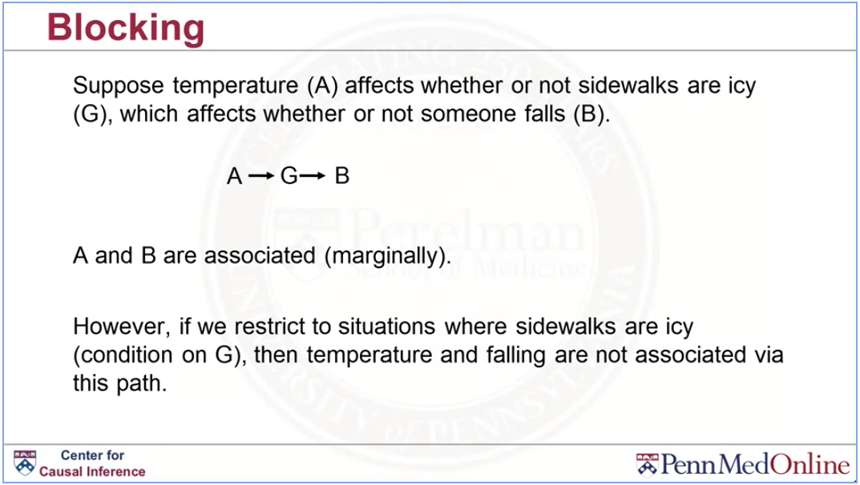

Slide 49
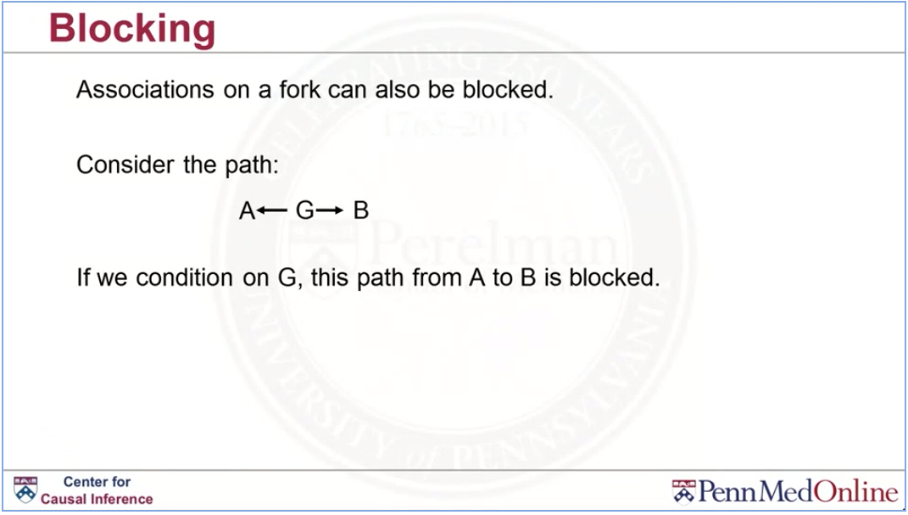

Slide 50
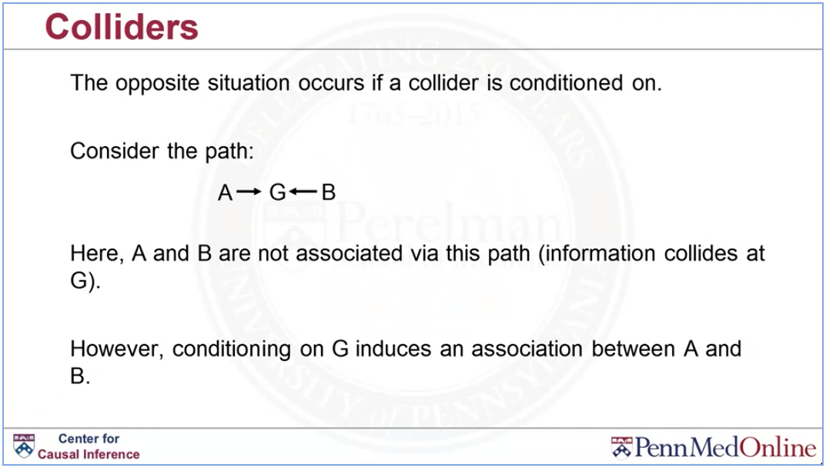

Slide 51
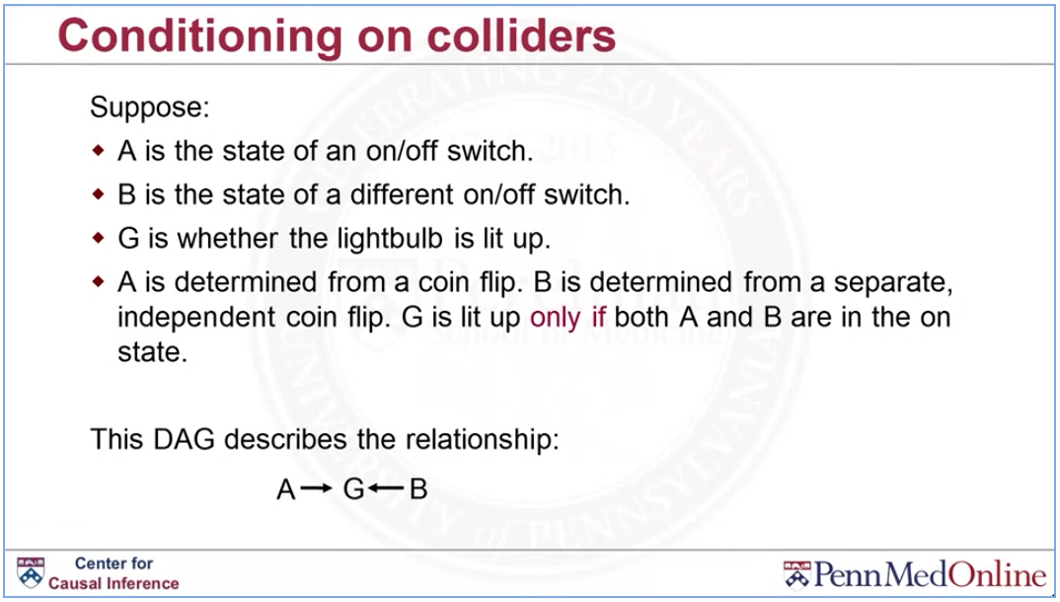
Notes:
Melhor analogia para collider
Deois interruptores e uma lampada

Slide 52
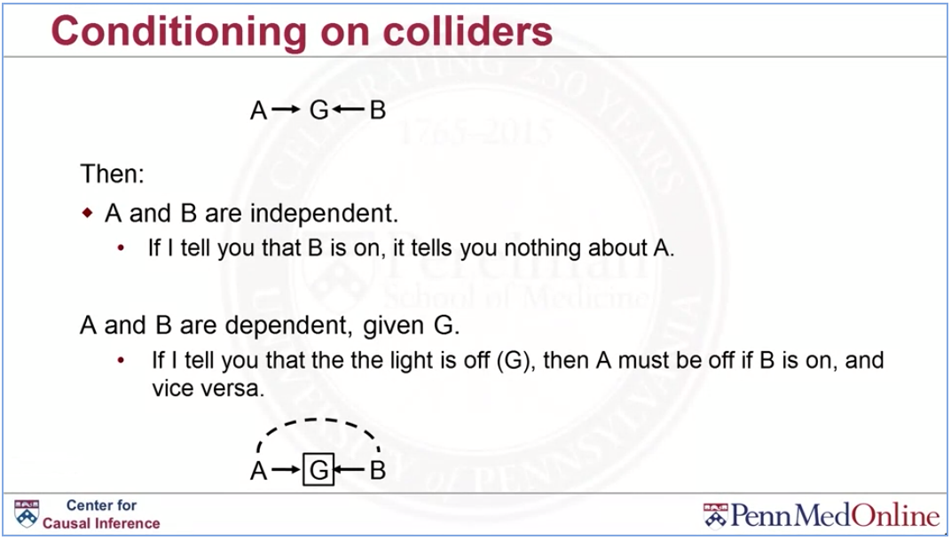

Slide 53
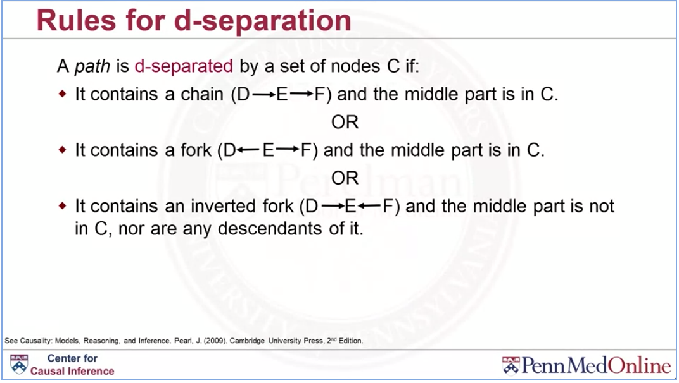

Slide 54
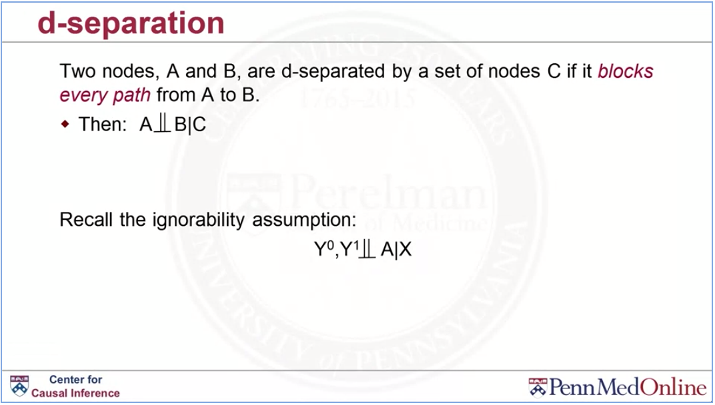

Slide 55
A <- X -> Y What type of this path is this?
Fork
2) A -> B -> C What type of path is this?
Chain
3) D -> B -> C This DAG is consistent with wich factorization of the joint distribution P(A,B,C,D)?
A^
P(D)P(A)P(B|D,A)P(C|B)
4) A -> B -> C Is there a collider on the path from A to C?
no

Slide 56
Confounders revisited

Slide 57
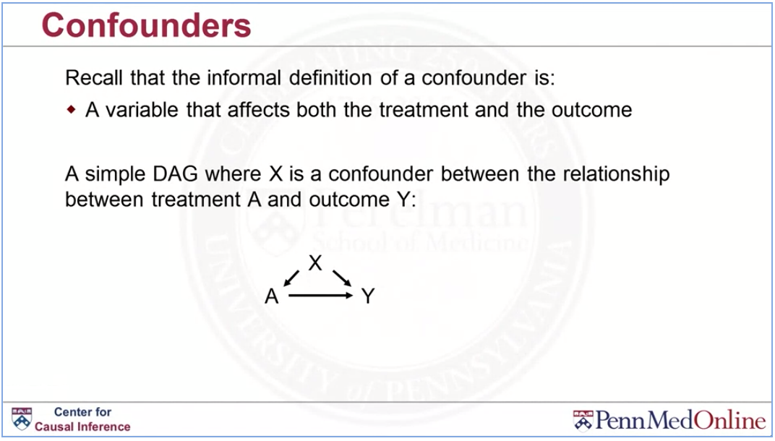

Slide 58
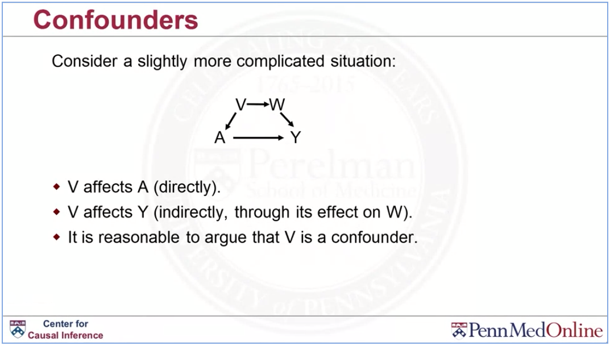

Slide 59


Slide 60


Slide 61


Slide 62


Slide 63


Slide 64


Slide 65


Slide 66
Backdoor path criterion

Slide 67


Slide 68


Slide 69


Slide 70


Slide 71


Slide 72


Slide 73


Slide 74


Slide 75


Slide 76


Slide 77


Slide 78


Slide 79


Slide 80


Slide 81


Slide 82
Disjunctive cause criterion

Slide 83


Slide 84


Slide 85


Slide 86


Slide 87


Slide 88


Slide 89


Slide 90


Slide 91


Slide 92


Slide 93





1 D->E->G->B
2 D->E->G->A->B
3 D->A->B
4 D->A<-G->B
1 D->A<-G->B

Slide 94



1 A<-B->Y
2 A<-B->C<-G->Y
3 A<-G->Y
4 A<-G->C<-B->Y
1 A<-B->Y
2 A<-G->Y

Slide 95




